Slide 1
Design Patterns
Chapter 5

Slide 2


Slide 3
One and Only One Object?
Can you give examples where this is important?

Slide 4
One and Only One Object?
If it’s so useful, how do you enforce it?
Can you allow one object, but not more than one?

Slide 5
Introduction: A Dialog
P. 171

Slide 6
More on Object Creation
Enforcing one and only one object
  Print servers, logging objects, a cache, etc.
“Singleton”
Must not have public constructors
  Duh
There are interesting variations
  And some nasty “gotchas”

Slide 7
Example: Class Objects
Class objects are singletons
  Java, Python, SmallTalk, etc.
  Enforced by the language:
    Class c = o.getClass( );
    Class c = Integer.class
    Class c = Class.forName(“MyClass”);
In Python they are also factories:
  f = Foo(“stuff”)
  >>> Foo
  <class __main__.Foo at 0x009E2750>
  >>> type(Foo)
  <type 'classobj'>

Slide 8
Singleton
The Basics
Use a static method to return the one and only (static) object
If it hasn’t been created yet, do so
You must return it by pointer/reference
  Of course (can’t copy)
And disallow copying/cloning and assignment (latter applies to C++ & C#)

Slide 9
Singleton.java
class Singleton {
private static Singleton theInstance;
private int theData = 2;
public int getData() {
return theData;
}
private Singleton() {}
public static Singleton getInstance() {
if (theInstance == null)
theInstance = new Singleton();
return theInstance;
}
}

Slide 10
Observations
Just call Singleton.getInstance( ) to get a reference to the object
  This is a kind of static factory, no?
Note that this function uses lazy instantiation:
  If it is never called, the object is never created
  So cool!

Slide 11
See Singleton Original

Slide 12

Dr. Frankenstein?
What have we created? Is it good?
  Is it useful to have a single copy of an object?
  Is it useful to enforce the use of one copy?
  There is at least one other benefit; covered later.
Or is it bad?
  Many people think Singleton is a Bad Thing
  Isn’t it just a global variable? Why are globals bad?
  Aren’t we hiding the “globalness?” Why is this bad?

Slide 13



Slide 14

Pattern Philosophy
Alexander’s view is that patterns should make the world a better place.
Does Singleton do so?
Is it a Pattern?
Or is it a programming hack?

Slide 15
Wouldn’t it be easier to…
… just create static objects?
Well, yes.
But what are the problems?

Slide 16
Object Dependencies
What if static object A depends on static object B?
Well, we could put them in the same file, with A after B
  Or can we always?
  Note: in C++, the order of instantiation of global variables found in different files is undefined.

Slide 17
Singleton to the Rescue
If A depends on B, and both A and B are Singletons, then:
  When A is created, it can access B through its Instance method
    If B didn’t exist before, it is created now.
    And Everyone is happy!
  See SingleDependent
What if A depends on B, and B depends on A? Does Singleton take care of it too?
  No, you ninny! You have a circular dependency! Go redesign your code!

Slide 18
C++ Variation #1
Unlike Java, C++ allows local static variables
  They are initialized only once
We can make the singleton a local static and dispense with the if-statement
  We return it by reference (we don’t have to, but we can)

Slide 19
C++ Variation #1
class Singleton {
int theData;
Singleton() {
theData = 2;
}
public:
static Singleton& getInstance() {
static Singleton theInstance;
return theInstance;
}
int getData() const {
return theData;
}
};

Slide 20
Using C++ Variation #1
int main() {
Singleton& s = Singleton::getInstance();
cout << s.getData() << endl;
}

Slide 21
C++ Variation 1 (local Static) Advantages
Easier to code
  (No external static definition needed)
Reference syntax
  Easier to read than pointer syntax
Automatic destruction
  Can be way important!!! (see example)

Slide 22
Singleton’s Secret
Sure it’s useful for enforcing one and only one object, but:
Its greatest benefit may be that it is an easy way to implement lazy instantiation
There are non-lazy Singletons, however…

Slide 23
C++ Variation #2
To make a class a singleton, we have to do a bit of surgery:
  Insert a static data member for the singleton
  Insert a static factory method
What if we could somehow “inherit” singleton-ness?
  With a minimum of intrusion?

Slide 24
Inheriting “Singleton-ness” doesn’t work!
Two problems:
  The same singleton object is shared by everybody
  That singleton object is the same type (whatever type it is!)
Non-CRTP shows how a counter is shared by different subclasses
So we need an automatically-generated singleton object (or pointer)
  That is unique
C++ has a cool, but arcane solution:

Slide 25
CRTP
The “Curiously Recurring Template Pattern”
  A special combination of templates (parametric polymorphism) and inheritance
A class, A, inherits from a template base parameterized on A itself!
  class A : public Base<A> { … };
  See crtp.cpp

Slide 26
CRTP
Why does it work?
Because the size of Base is not dependent on its template parameter T
  Its size can be computed once and for all (0)
So let’s make a base class that provides singleton-ness instead of counting!
  See CuriousSingleton.cpp

Slide 27
Making A a Singleton via CRTP
Make its constructor non-public
Make Singleton<A> a friend of A
  So Singleton<A> can instantiate a singleton of type A
Don’t instantiate A anywhere inside A
  A has access to all constructors, of course

Slide 28
Consequences of Singleton
Benefits:
  Enforces a single object
  Lazy instantiation (when it works!)
Downsides:
  Repeated evaluation of if is inefficient
  Users know they’re using a singleton (can’t hide it)
  Destruction is problematic (When? Don’t want a dangling reference)

Slide 29
Problems with Lazy Instantiation
With multiple threads, it is possible to get two objects created
See page 178, 179

Slide 30
Eager Instantiation
public class Singleton {
private static Singleton uniqueInstance =
new Singleton();
private Singleton() {}
public static Singleton getInstance() {
return uniqueInstance;
}
}
But this creates an object whether you need it or not.
What if you need lazy instantiation?

Slide 31
Solution
Can make the instance method synchronized (P. 180)
  But synchronization is expensive
  … which defeats the purpose of lazy instantiation (efficiency)
Alternatives: (Page 181)
  Do nothing if performance isn’t an issue
  Go back to Eager Instantiation
  Or synchronize only when needed

Slide 32
Synchronized
public class Singleton {
private static Singleton uniqueInstance;
private Singleton() {}
public static synchronized Singleton getInstance()
{
if (uniqueInstance == null) {
uniqueInstance = new Singleton();
}
return uniqueInstance;
}
}
But locking is expensive! Every time you call getInstance() it costs time.

Slide 33
Alternative 3: double-checked-locking

Slide 34
The volatile keyword
Has a different meaning than in C++
Has to do with immediate updates of memory in Java
  Non-volatile objects are cached by each thread
  Volatile objects act as if not cached

Slide 35
Double-Checked Locking
public class Singleton {
private volatile static Singleton uniqueInstance;
private Singleton() {}
public static Singleton getInstance() {
if (uniqueInstance == null) {
synchronized (Singleton.class) {
if (uniqueInstance == null)
uniqueInstance = new Singleton();
}
}
return uniqueInstance;
}
}

Slide 36
The General Pattern:
Double-Checked Locking
A common way of avoiding race conditions … is to serialize access to its critical sections. … This design, however, can incur excessive locking overhead if the object’s critical section is entered frequently but is executed conditionally only once.
Therefore:
Provide the shared object with a ‘hint’ as to whether execution of a particular critical section is necessary. Check this hint before and after acquiring the lock that guards this critical section.
It’s NOT just for Singleton.

Slide 37
Another Java Variation
public class BillPughSingleton {
private BillPughSingleton(){}
private static class SingletonHelper{
private static final BillPughSingleton INSTANCE =
new BillPughSingleton();
}
public static BillPughSingleton getInstance(){
return SingletonHelper.INSTANCE;
}
}

Slide 38
C++: The local static variable approach does NOT need double-checked locking
Java: the private local static class approach does NOT need double-checked locking
So use them. They are easier anyway.

Slide 39
No Dumb Questions
P. 184

Slide 40
Singletons and Subclassing
What if a class derives from a Singleton?
  Singleton’s constructor must be protected
Therefore, each derived object will have its own copy!
  Maybe that’s okay, maybe not
  And the derived class is not a singleton
Know what you’re doing!

Slide 41
Another Approach
Why not just use static variables?
That’s fine, but you may want to treat it as an object
  To allow polymorphism
This is the Monostate Pattern
  See monostate.cpp

Slide 42
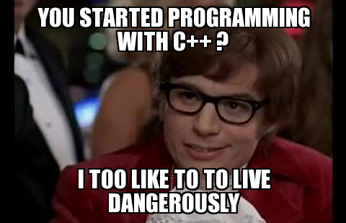

Slide 43
A Monostate “Factory”
Monostate is a single class
We may want multiple singletons
  Printer, database, …
CRTP to the rescue
  We need separate classes
  We’ll use templates and CRTP

Slide 44
Consequences of Monostate
Benefits:
  Users don’t know they’re using a singleton
  Subclasses are automatically singletons
  Polymorphism (methods can be overridden)
  Well-defined creation and destruction times
Downsides:
  Multiple (albeit small) objects get created
  Space is used even if users don’t use any objects

Slide 45


Slide 46
C++ Variation
Named Expanding Monostate
Uses member templates to allow automatic expansion of class attributes
Each data attribute has its own function that it is local to
It is identified by its type and an arbitrary number
  These are encapsulated in a Name class template
See namedmono.cpp

Slide 47
How do you Kill a Singleton?
In C++, using pointers, you may have a dangling object. How do you ensure it is cleaned up?
Or: you want to destroy it at a certain time
  E.g., when all users are gone
You write a Destroyer class

Slide 48
Multi-Singleton?
Suppose you want exactly N objects, not just a Single one?
Easiest: Wrap an array of the objects with a Singleton
  But you lose some lazy instantiation – all objects in the array are created together
In C++, you can write a multi-singleton template
Pick whatever approach is best for you

Slide 49
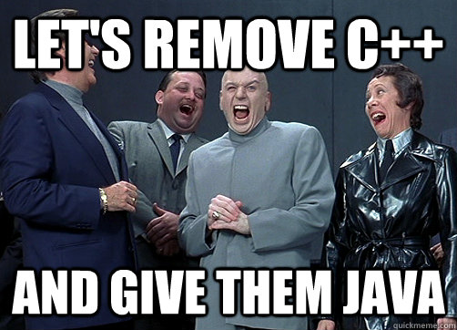

Slide 50
Summary
Patterns
  Singleton
  Double-Checked Locking
    DCL is NOT part of the Singleton Pattern!!!!!
    It’s a separate pattern!
  (CRTP – the Curiously Recurring Template Pattern) (For C++ nerds)

